Slide 1
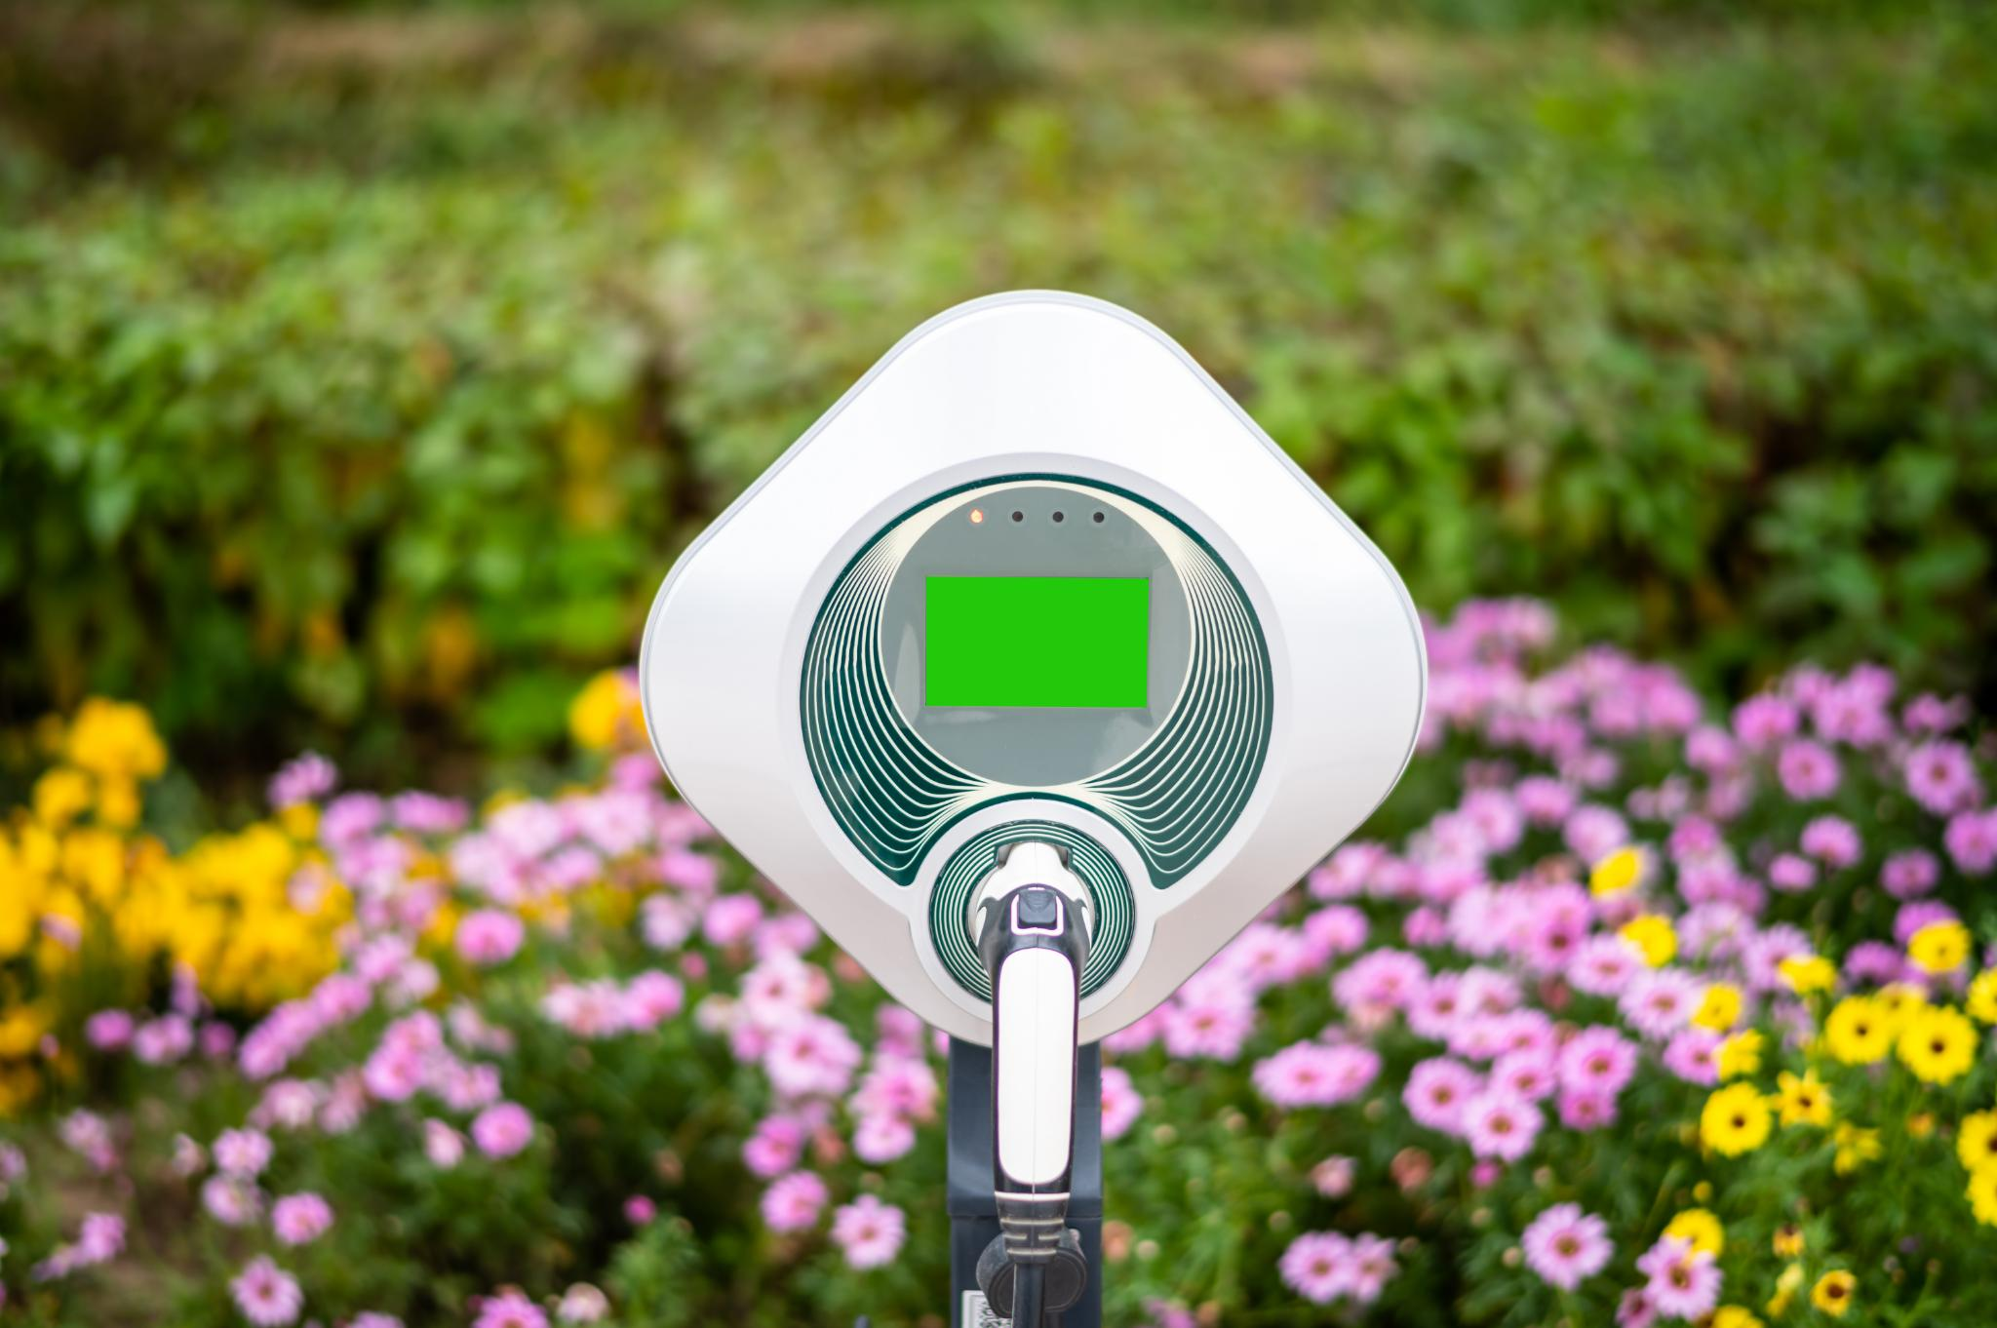
Automated Garden System: Integration of ESP + LoRa & Raspberry Pi for Efficient Garden Management
Innovative technologies for smart garden solutions
Notes:
AI-generated content may be incorrect. --- In this presentation, we will explore the innovative solutions of garden automation through ESP, LoRa, and Raspberry Pi technologies. Our focus will be on how these technologies can streamline garden management, ensuring efficient water usage and optimal plant care. Image source: Microsoft 365 content library

Slide 2
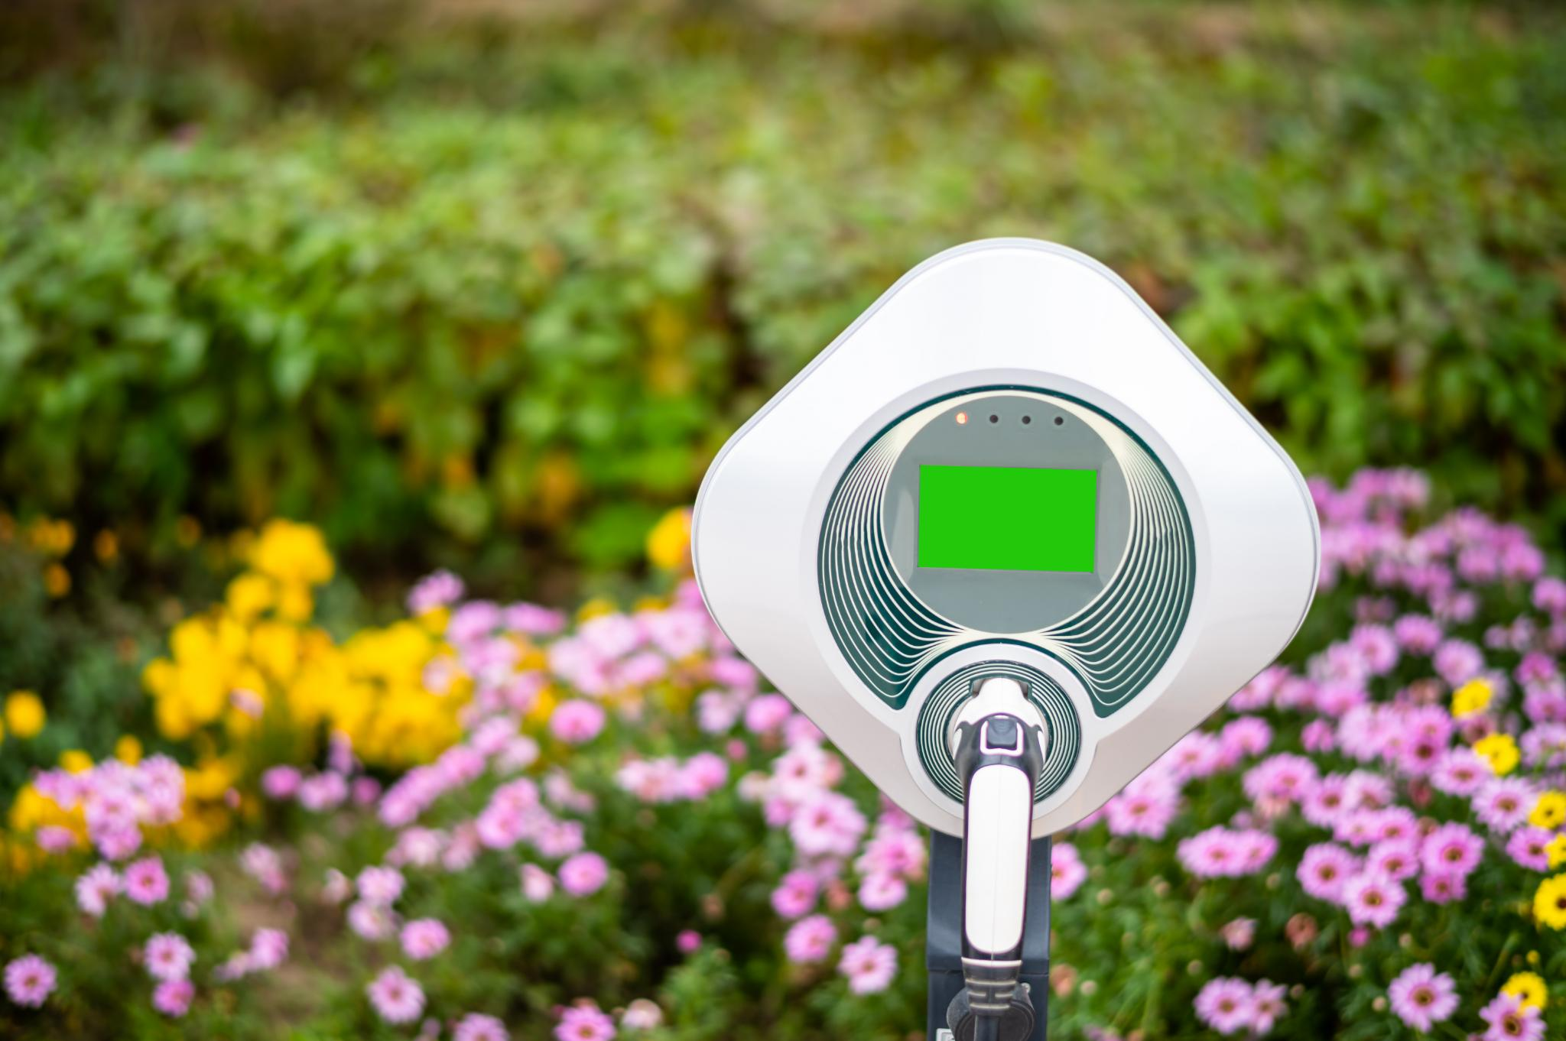
Topics to be Discussed
Introduction to Garden Automation
System Architecture and Components
Sensors and Controllers
Communication Protocols and Data Flow
Implementation and Programming
Monitoring and Maintenance
Costs and Conclusion
Notes:
--- We will cover key topics including an introduction to garden automation, the system architecture and its components, the role of sensors and controllers, communication protocols, implementation guide, and strategies for monitoring and maintenance. Image source: Microsoft 365 content library

Slide 3
Investing in Your Garden's Future
Automation technologies enhance efficiency in garden management.
Investing now saves time and resources in the long run.
Smart systems lead to healthier plants and better yields.
Modern garden solutions provide remote monitoring and control.
Quality components ensure durability and optimal performance.
Notes:
This slide focuses on the benefits of investing in garden automation. By utilizing advanced technologies, you'll achieve greater efficiency and healthier plants. Although the initial investment may seem high, the long-term savings in time and resources make it worthwhile. Additionally, the convenience of smart systems allows for remote management, offering you peace of mind and optimal performance.

Slide 4
Introduction to Garden Automation
Notes:
Garden automation utilizes technology to manage garden conditions efficiently. This section will provide an overview of what automated garden systems are and their significance in modern gardening.

Slide 5
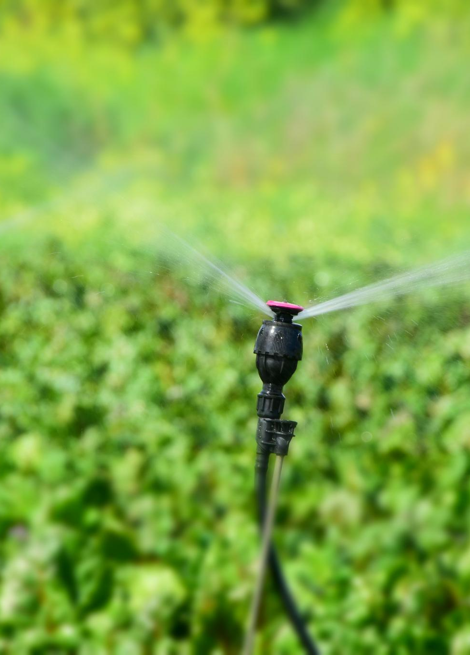
Overview of Automated Garden Systems
Sensor Technology
Automated garden systems utilize sensor technology to monitor soil moisture, temperature, and other critical variables for plant health.
Irrigation Management
These systems automatically manage irrigation schedules, ensuring plants receive the right amount of water without manual intervention.
Labor Reduction
By automating garden care, these systems significantly reduce manual labor, allowing for more efficient gardening practices.
Notes:
--- Automated garden systems use sensors and controllers to monitor and manage various aspects of garden care, including irrigation, soil moisture, and temperature. They help reduce manual labor and ensure optimal conditions for plant growth. Image source: Microsoft 365 content library

Slide 6
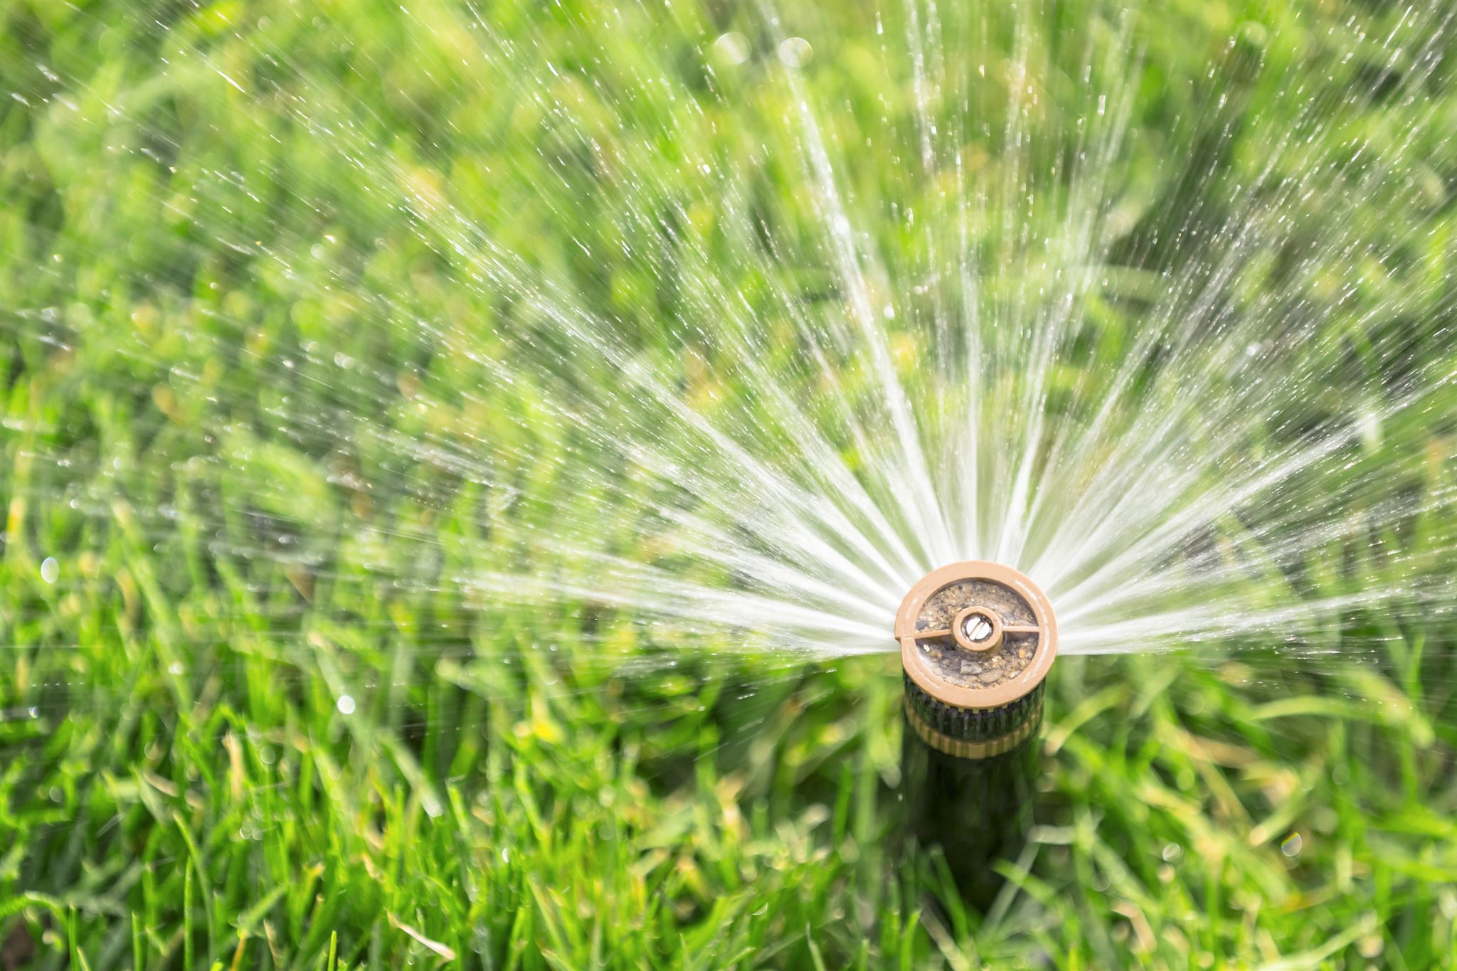
Benefits of Garden Automation
Improved Water Efficiency
Garden automation allows for precise watering, reducing water waste and ensuring plants receive the right amount of hydration.
Reduced Labor Costs
With automation, less manual labor is required for garden maintenance, allowing for more time-efficient gardening practices.
Enhanced Plant Health
Automated systems can monitor and adjust conditions for optimal plant growth, leading to healthier plants and better yields.
Remote Monitoring and Control
Garden automation allows you to monitor and control your garden from anywhere using smart devices, enhancing convenience.
Notes:
--- Automating your garden comes with several benefits, including improved water efficiency, reduced labor costs, enhanced plant health, and the ability to remotely monitor and control your garden from anywhere. Image source: Microsoft 365 content library

Slide 7
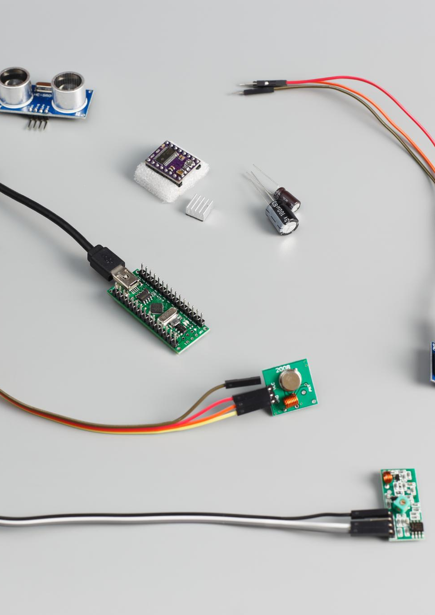
Components Involved in Garden Automation
Environmental Sensors
Sensors are used to monitor environmental conditions such as soil moisture, temperature, and humidity, ensuring optimal plant growth.
Controllers
Controllers execute commands based on data received from sensors, allowing automated irrigation and lighting systems to function effectively.
Central Processing Unit
A central processing unit, such as Raspberry Pi, manages data flow and integrates various components of the automated garden system.
Notes:
--- Key components of an automated garden system include sensors for monitoring environmental conditions, controllers for executing commands, and a central processing unit like Raspberry Pi to manage the data flow. Image source: Microsoft 365 content library

Slide 8
Costs of Garden Automation
Initial Setup Costs can be significant due to equipment and technology.
Ongoing Maintenance expenses ensure system efficiency and reliability.
Potential Savings in water and labor costs over time can offset investments.
Investment in quality sensors leads to better long-term performance.
Consideration of energy costs for running automated systems is essential.
Notes:
This slide addresses the various costs associated with garden automation. Initial setup costs can be high due to the necessary technology and equipment. However, ongoing maintenance is crucial for ensuring the system remains efficient. It's important to also consider the potential savings in water and labor costs, which can help offset the initial investments over time.

Slide 9
System Architecture and Components
Notes:
This section will delve into the architecture of the automated garden system, explaining how the various components interact to create a cohesive and functional system.

Slide 10
Description of the Two Gardens
Distinct Garden Designs
Each garden is designed with specific plants that thrive in their unique conditions, enhancing growth and health.
Tailored Care and Management
The segmentation of gardens allows for customized care strategies, ensuring optimal growth and resource utilization.
Optimizing Resources
By managing the gardens separately, resources are optimized, leading to improved output and sustainability.
Notes:
--- The system includes two distinct gardens, each designed for specific plants and conditions. This segmentation allows for tailored care and management, optimizing resources and output. Image source: Microsoft 365 content library

Slide 11
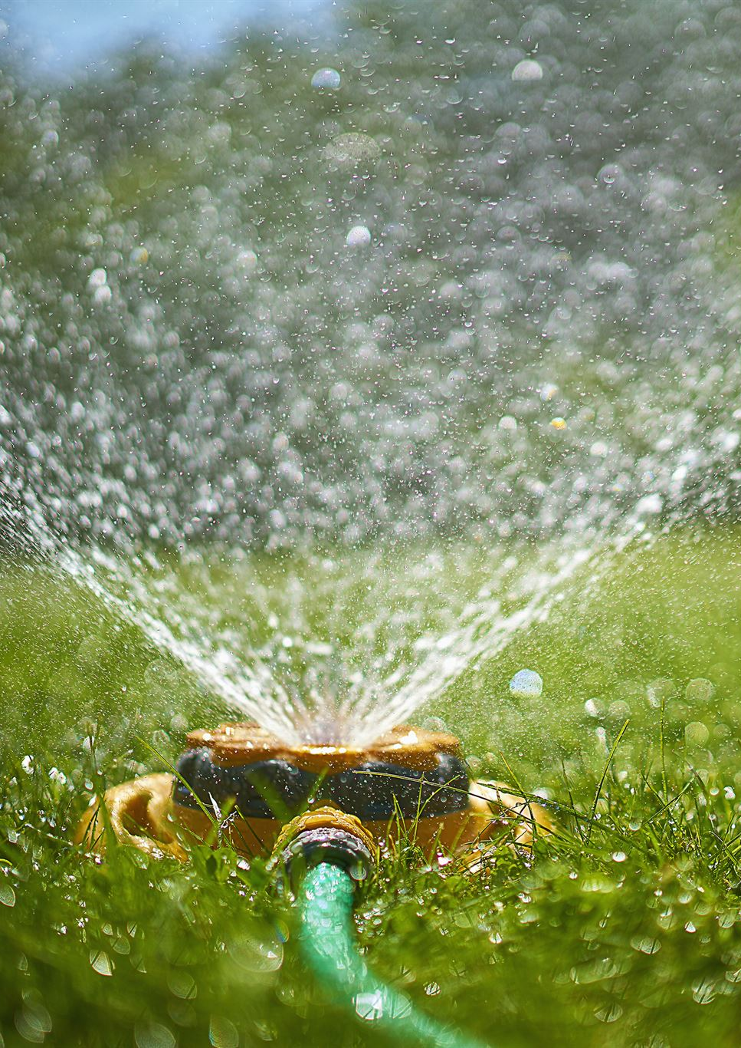
Water Central Setup and Functionality
Irrigation Management
The Water Central effectively manages irrigation across gardens, ensuring optimal water usage and plant health.
Soil Moisture Sensors
Connected soil moisture sensors provide real-time data to the Water Central, enabling precise control of watering schedules.
Automated Watering
The automation feature of the Water Central waters the gardens based on real-time soil moisture levels, reducing wastage.
Notes:
--- The Water Central is a critical component that manages irrigation across the gardens. It connects to soil moisture sensors and automates watering based on real-time data to maintain optimal soil conditions. Image source: Microsoft 365 content library

Slide 12

Repository Levels for Optimal Water Management
Monitoring water levels ensures consistent availability.
Implementing alerts for low water levels enhances management.
Regular checks on repositories prevent water shortages.
Integration with automation allows for timely replenishment.
Strategic design of repositories maximizes water retention.
Notes:
In this slide, we highlight the importance of monitoring repository water levels to ensure that gardens do not run out of water. Implementing an alert system for low levels can greatly enhance management practices. Regular checks and strategic designs of the repositories work towards preventing shortages and maximizing water retention in the system.

Slide 13
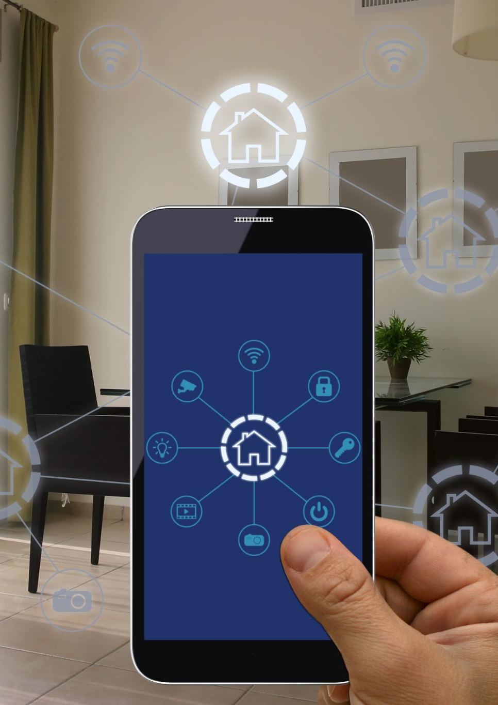
Control Central in the House
Centralized Control System
The Control Central acts as the brain of the house, integrating various systems for efficient management.
Data Collection
It collects data from gardens, allowing for informed decision-making and resource management.
Irrigation Management
The system efficiently controls watering systems, ensuring gardens receive the right amount of water.
Notes:
--- The Control Central, located within the house, serves as the brain of the operation. It collects data from both gardens and controls the watering systems, ensuring efficient management and quick decision-making. Image source: Microsoft 365 content library

Slide 14
Sensors and Controllers
Notes:
In this section, we will discuss the role of sensors and controllers, including their placement and integration into the overall system, and how they contribute to the automation process.

Slide 15
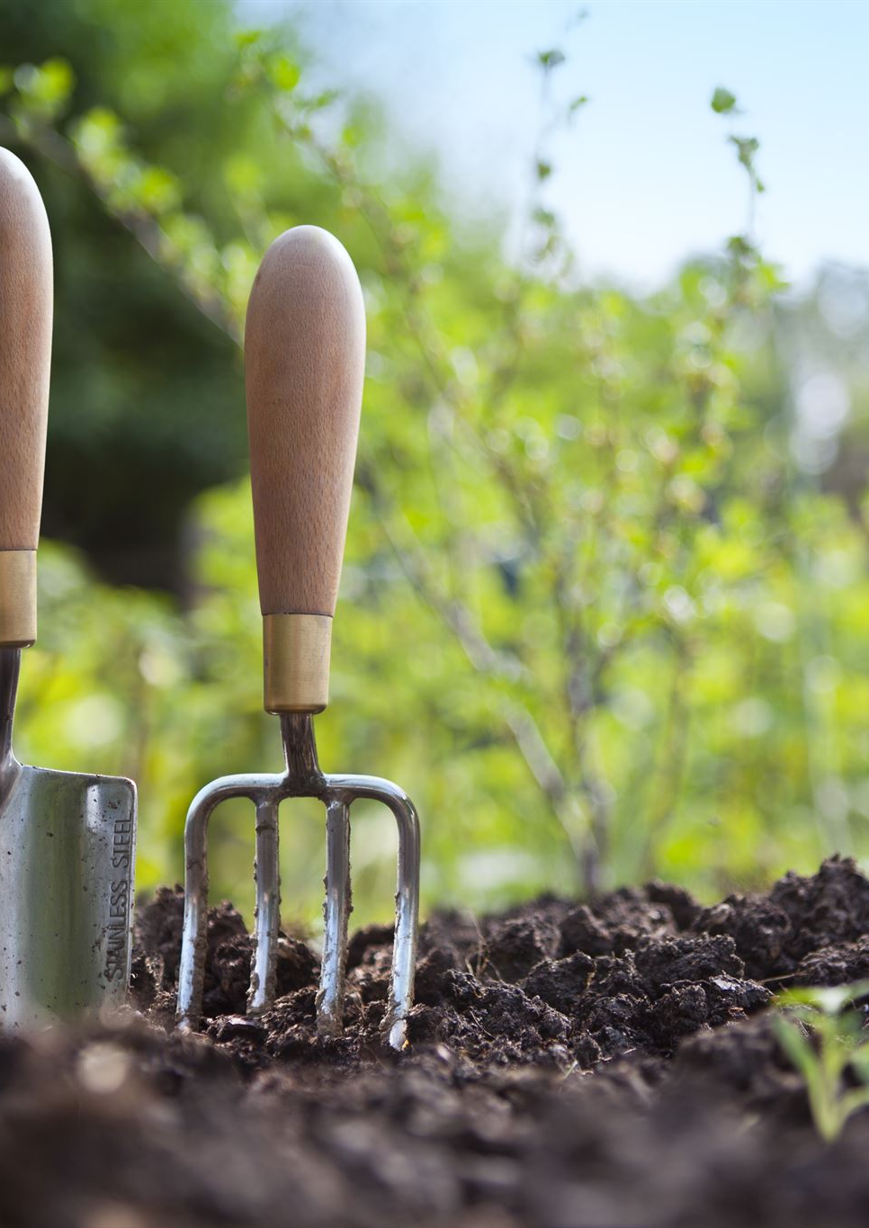
Placement and Function of Humidity Sensors
Strategic Sensor Placement
Humidity sensors are strategically placed throughout the garden to ensure accurate monitoring of soil moisture levels.
Monitoring Soil Moisture
These sensors effectively monitor soil moisture, providing essential data for optimal watering practices.
Preventing Over/Under-Watering
The data collected is crucial for determining ideal watering times, preventing both over and under-watering of plants.
Notes:
--- Humidity sensors are strategically placed in the gardens to monitor soil moisture levels. This data is crucial for determining when to water, preventing over or under-watering. Image source: Microsoft 365 content library

Slide 16
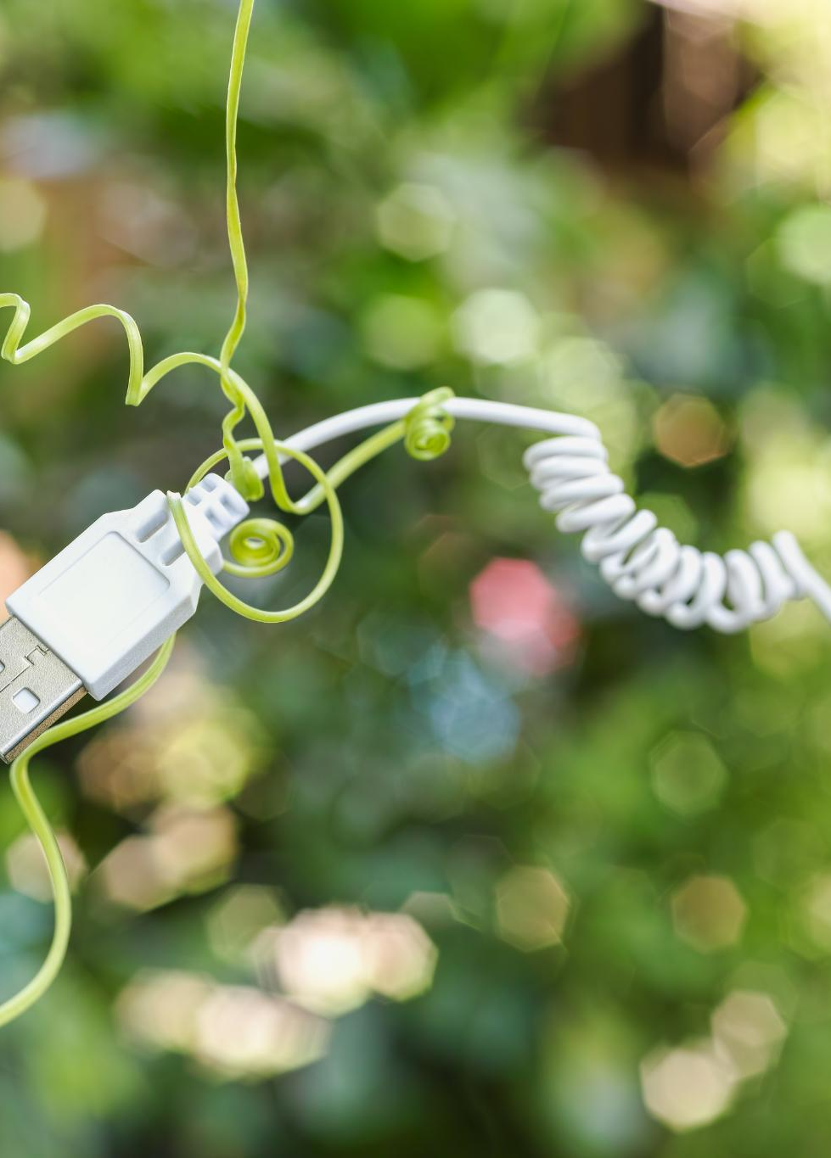
Role of ESP + LoRa Controllers in the Garden and Water Central
Enhanced Communication
ESP and LoRa controllers enable seamless communication between various sensors and the Control Central, optimizing garden management.
Long-Range Monitoring
The long-range capabilities of these controllers ensure effective monitoring over larger garden spaces, improving reliability.
System Reliability
Utilizing ESP and LoRa technology enhances the reliability of data transmission and sensor functionality within the garden.
Notes:
--- ESP and LoRa controllers facilitate communication between the sensors and the Control Central. Their long-range capabilities allow for effective monitoring across larger garden spaces, enhancing system reliability. Image source: Microsoft 365 content library

Slide 17
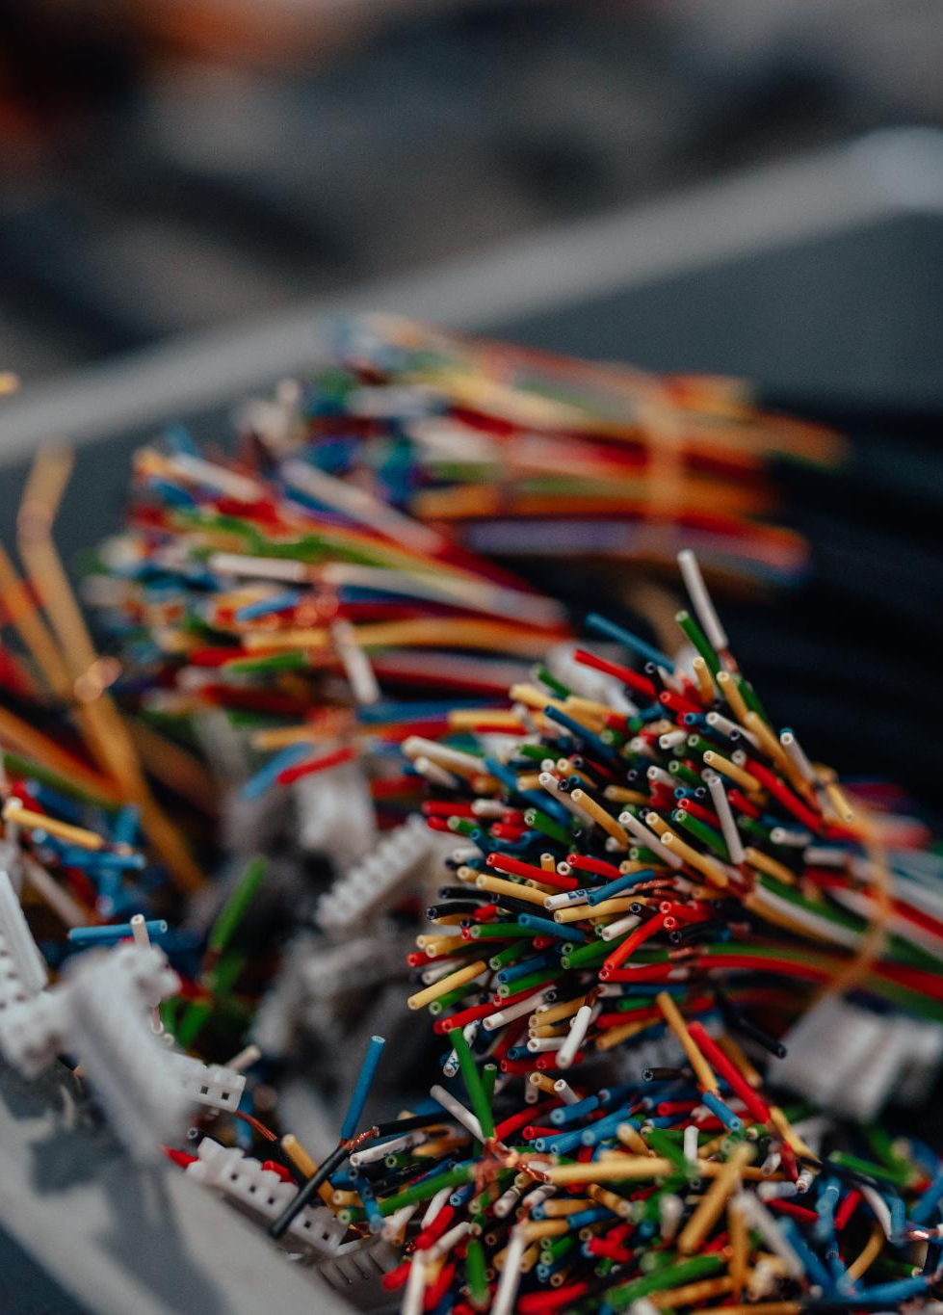
Integration with the Raspberry Pi Central Controller
Centralized Data Processing
Raspberry Pi acts as a central hub for collecting and processing data from various sensors in the garden.
Automating Garden Management
With predefined conditions, the Raspberry Pi can automate decisions for irrigation, lighting, and other gardening tasks to optimize growth.
Sensor Integration
Various sensors can be integrated with the Raspberry Pi to monitor soil moisture, temperature, and more for better garden health.
Notes:
--- The Raspberry Pi serves as the central controller, processing the data received from sensors and making decisions based on predefined conditions for effective garden management. Image source: Microsoft 365 content library

Slide 18
Communication Protocols and Data Flow
Notes:
This section will cover the communication protocols used in the automated garden system and how data flows between the components to facilitate effective management.

Slide 19
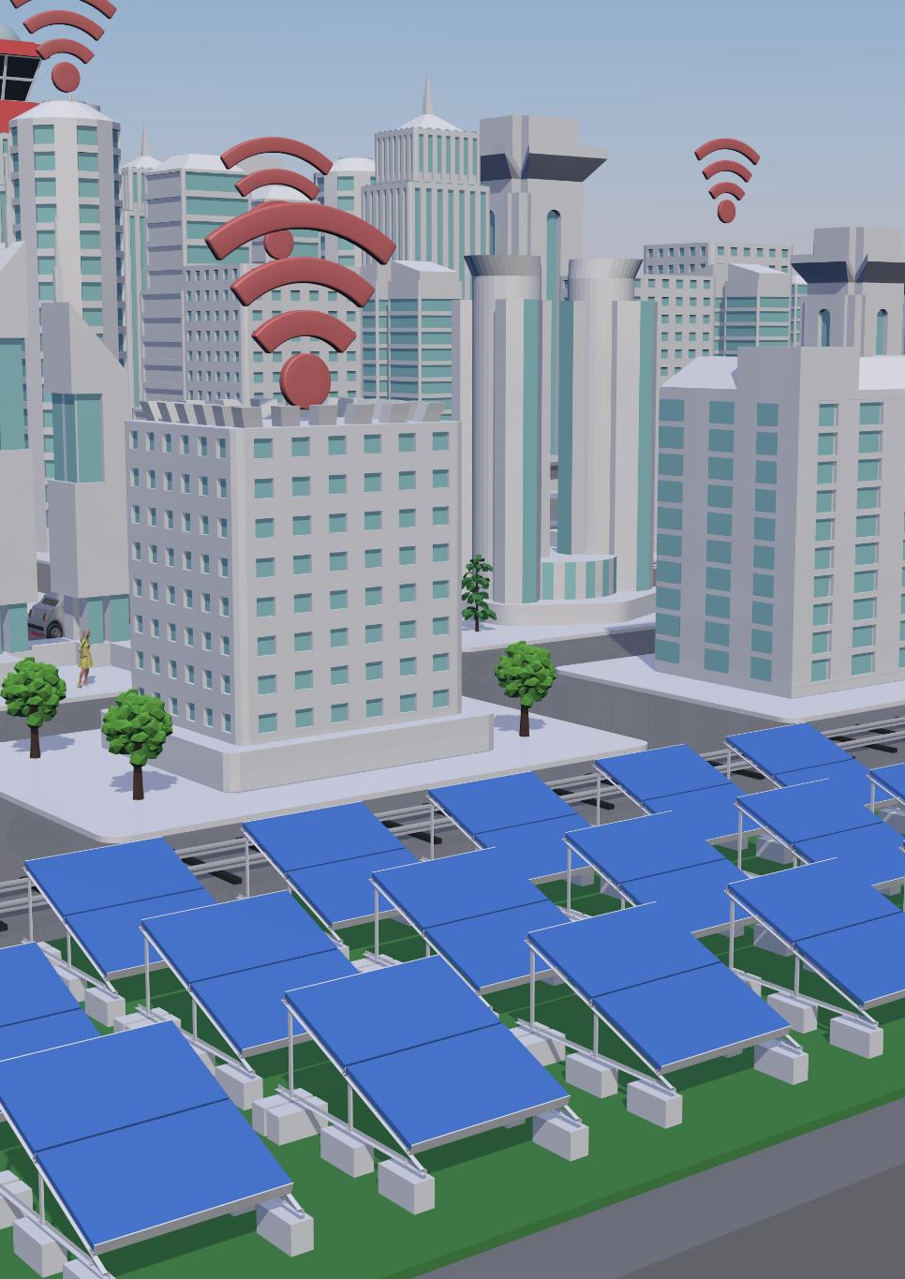
ESP + LoRa Communication Protocol
Low-Power Data Transmission
ESP and LoRa protocols facilitate low-power communication, making them ideal for battery-operated devices.
Long-Range Connectivity
These protocols support long-range data transmission, allowing devices to communicate over vast distances.
Performance in Challenging Conditions
ESP and LoRa protocols maintain communication effectiveness even in challenging environmental conditions.
Notes:
--- The ESP and LoRa communication protocols enable low-power, long-range data transmission. This efficient protocol allows the system to operate effectively even in challenging environmental conditions. Image source: Microsoft 365 content library

Slide 20
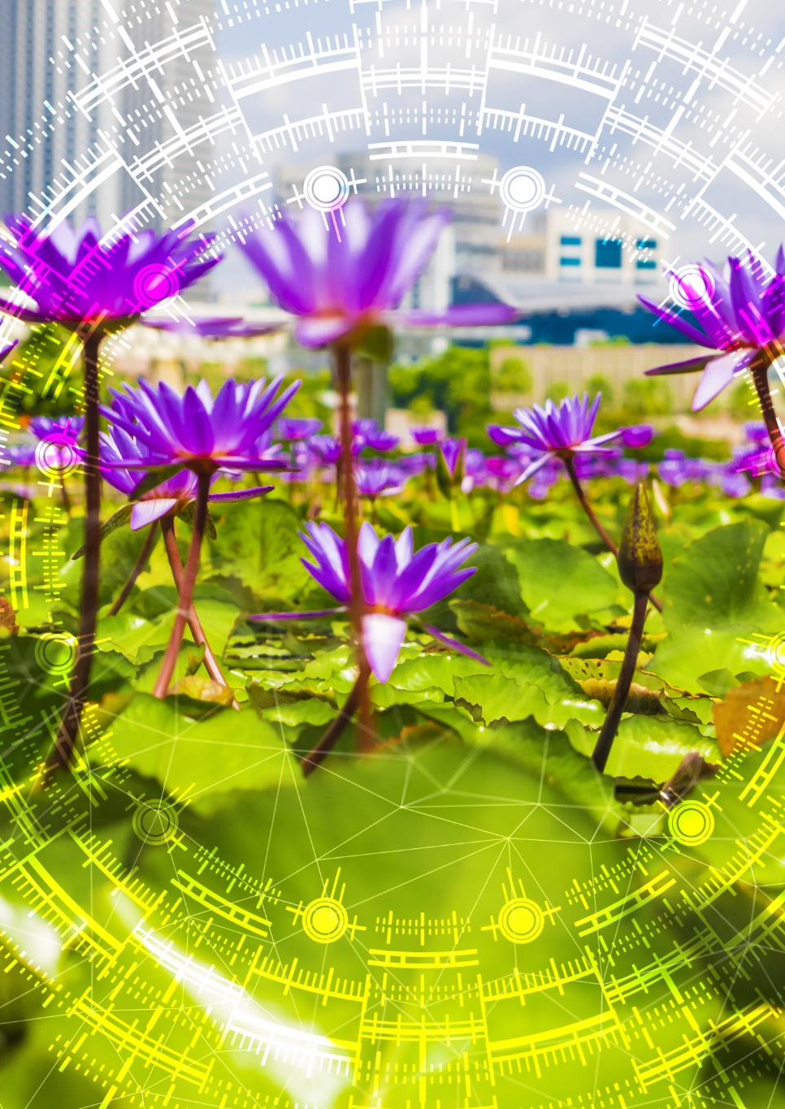
Data Transmission Between Garden, Water Central, and Control Central
Real-Time Data Transmission
Data is transmitted in real time from gardens to both the Water Central and Control Central, ensuring timely updates.
Synchronization of Components
The system ensures that all components are synchronized, allowing for efficient responses to changing environmental conditions.
Response to Changing Conditions
Quick response capabilities are crucial for adapting to changing conditions, which improves overall system efficiency.
Notes:
--- Data from the gardens is transmitted to the Water Central and Control Central in real time. This ensures that all components are synchronized and can respond quickly to changing conditions. Image source: Microsoft 365 content library

Slide 21
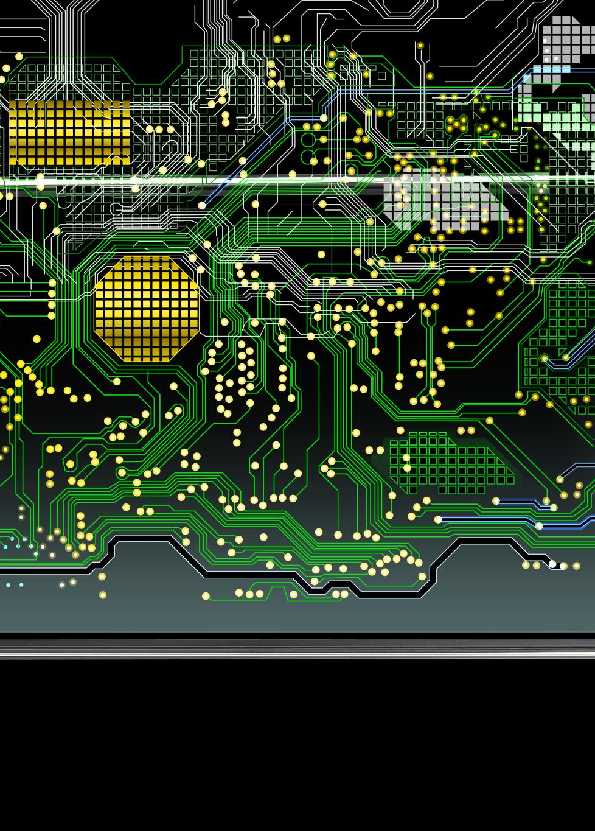
Managing and Processing Data Using Raspberry Pi
Data Processing
Raspberry Pi efficiently processes incoming data, allowing for real-time analysis and decision making.
Automation Commands
It executes commands for irrigation and various automation tasks, enhancing efficiency and resource management.
Central Hub
Raspberry Pi serves as a central hub, integrating various components of the automation system for seamless operation.
Notes:
--- Raspberry Pi processes the incoming data, analyzes it, and executes commands for watering and other automation tasks. Its capabilities make it an ideal central hub for the system. Image source: Microsoft 365 content library

Slide 22
Implementation and Programming
Notes:
In this section, we will discuss how to set up the hardware and program the components to create a fully functioning automated garden system.

Slide 23
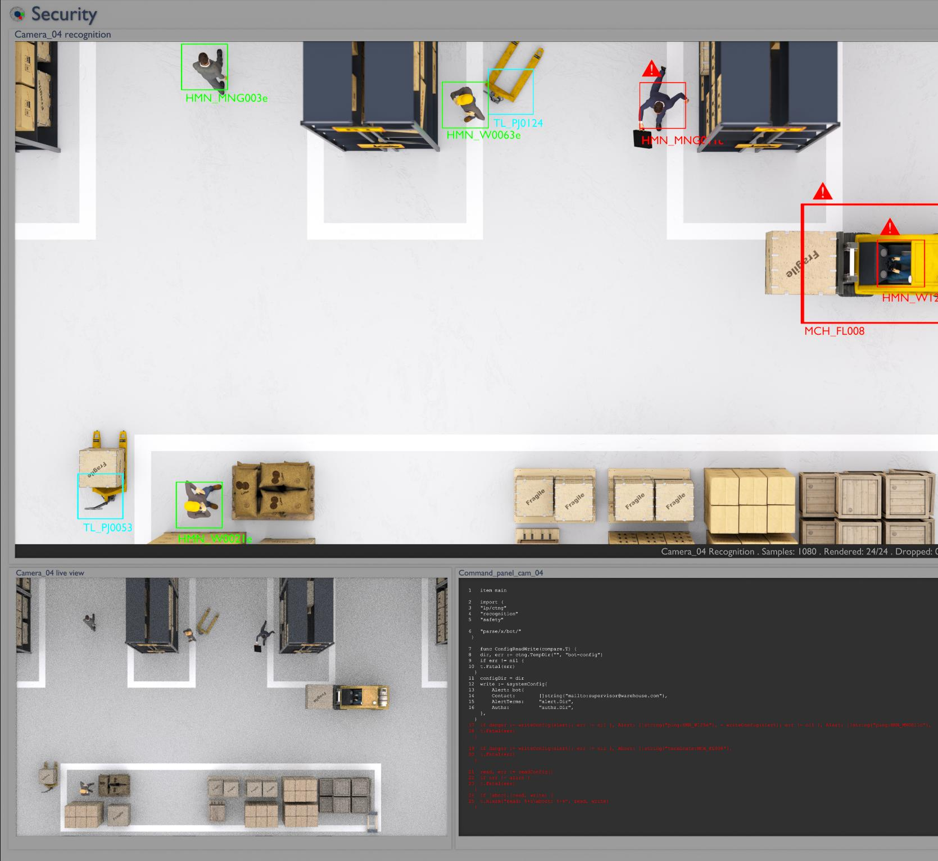
Setting up the Hardware
Importance of Hardware Setup
A well-planned hardware setup is essential for the efficient operation of the automated garden system, ensuring all components work together seamlessly.
Connecting Sensors and Controllers
Properly connecting sensors and controllers is critical for monitoring environmental conditions and managing the automated garden effectively.
Raspberry Pi Integration
Integrating the Raspberry Pi into the hardware setup allows for advanced control and monitoring of the automated garden system.
Notes:
--- The hardware setup is crucial for the success of the automated garden system. This includes connecting sensors, controllers, and the Raspberry Pi in a way that ensures optimal performance. Image source: Microsoft 365 content library

Slide 24
Programming ESP + LoRa Controllers
Importance of Programming
Programming the ESP + LoRa controllers ensures proper functionality and efficient communication between devices.
Firmware Setup
Setting up the firmware is crucial for data handling and system integration, enabling devices to work seamlessly.
Data Communication
Effective programming facilitates reliable data communication between the ESP and LoRa components, enhancing system performance.
Notes:
--- Programming the ESP + LoRa controllers is essential for their functionality. This involves setting up the firmware to facilitate communication and data handling between the system components. Image source: Microsoft 365 content library

Slide 25
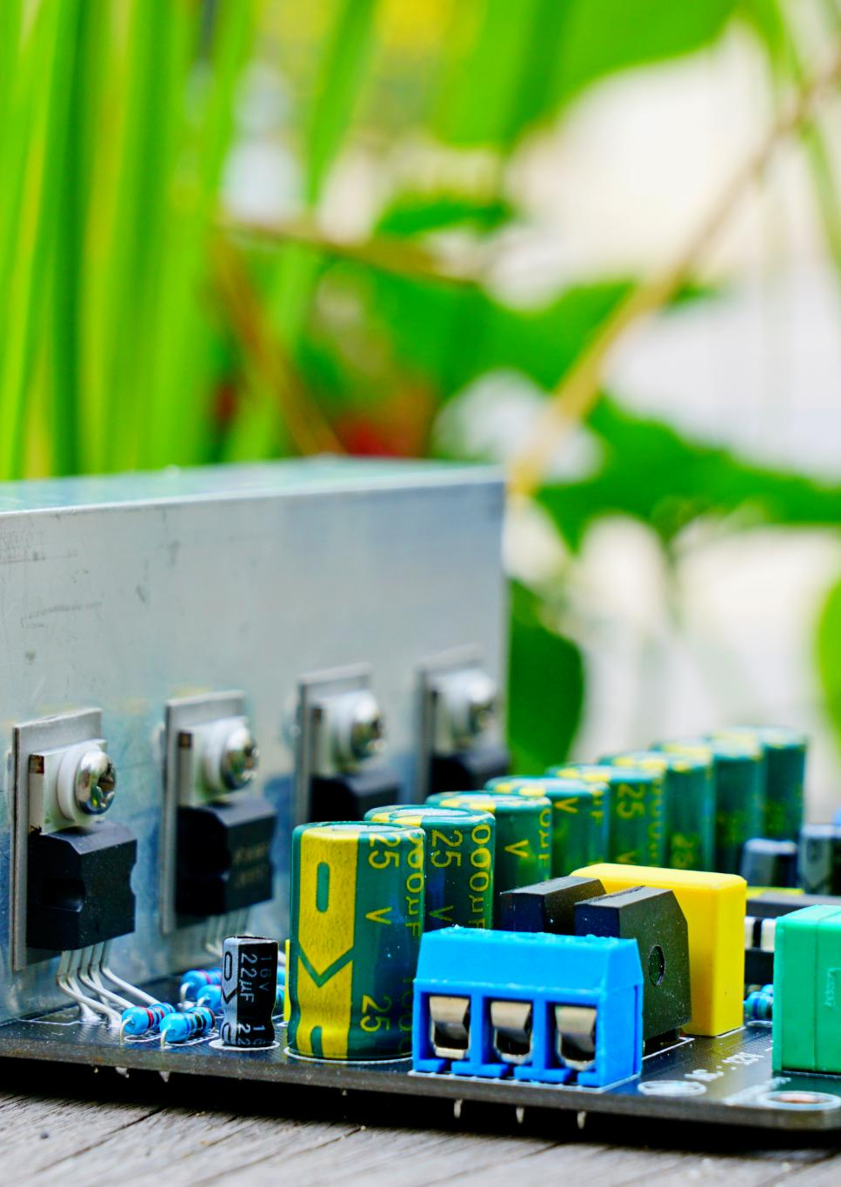
Configuring the Raspberry Pi for Garden Automation
Software Installation
Installing the necessary software on the Raspberry Pi is crucial for controlling the garden automation system efficiently.
Script Configuration
Setting up scripts for automated tasks allows the Raspberry Pi to manage watering, lighting, and monitoring in the garden.
System Management
Proper configuration ensures effective management of the automated garden system, leading to optimal plant care.
Notes:
--- The Raspberry Pi must be configured correctly to manage the automated garden system effectively. This includes installing necessary software and setting up scripts for automated tasks. Image source: Microsoft 365 content library

Slide 26
Monitoring and Maintenance
Notes:
Regular monitoring and maintenance are key to ensuring the long-term success of an automated garden system. This section will cover best practices for keeping the system functioning optimally.

Slide 27
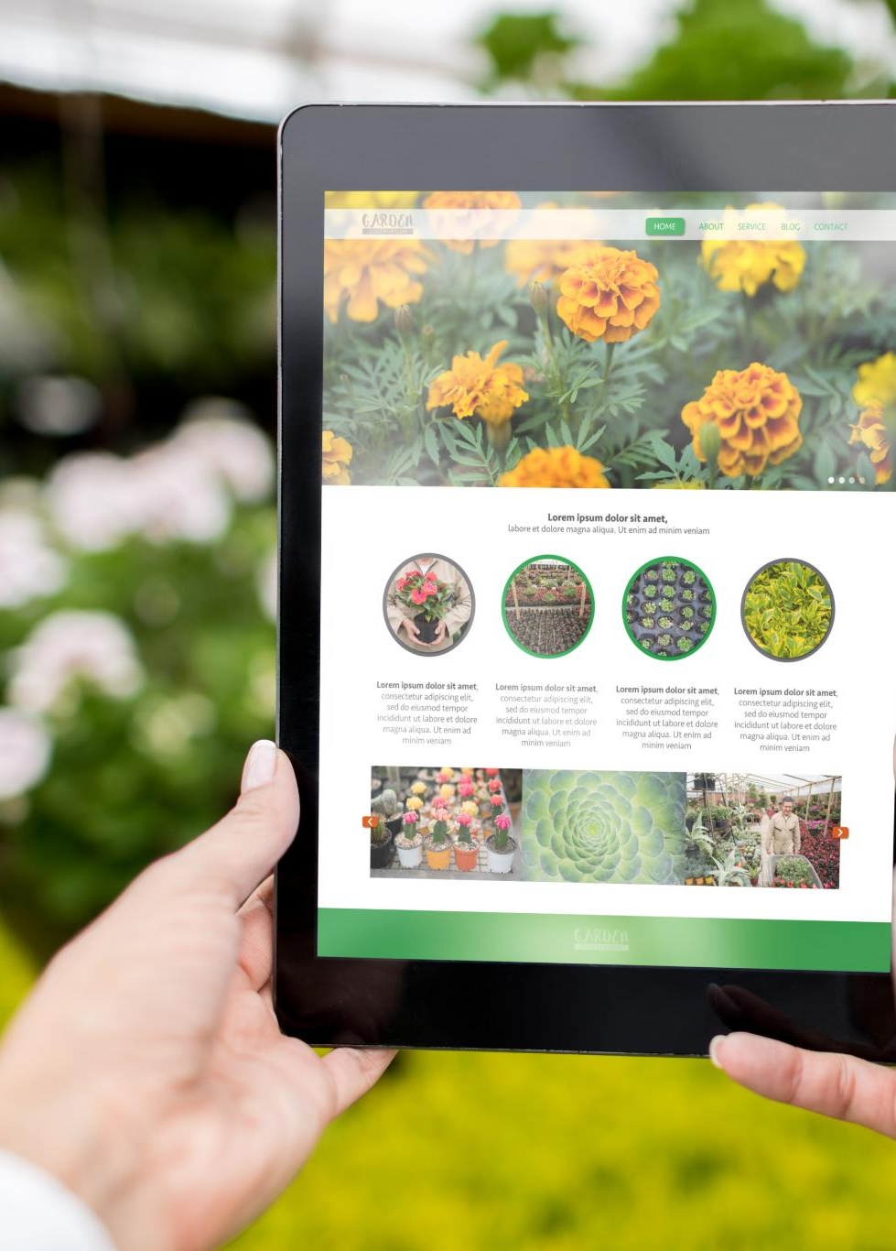
Real-Time Monitoring of Garden Conditions
Immediate Response
Real-time monitoring enables quick responses to fluctuations in garden conditions, enhancing plant health.
Live Data Access
Accessing live data ensures that gardeners can make informed decisions for optimal care of plants.
Optimal Plant Care
Real-time data helps maintain optimal conditions for plants, leading to better growth and yield.
Notes:
--- Real-time monitoring allows for immediate responses to changing garden conditions. Access to live data keeps the system responsive and ensures optimal plant care. Image source: Microsoft 365 content library

Slide 28
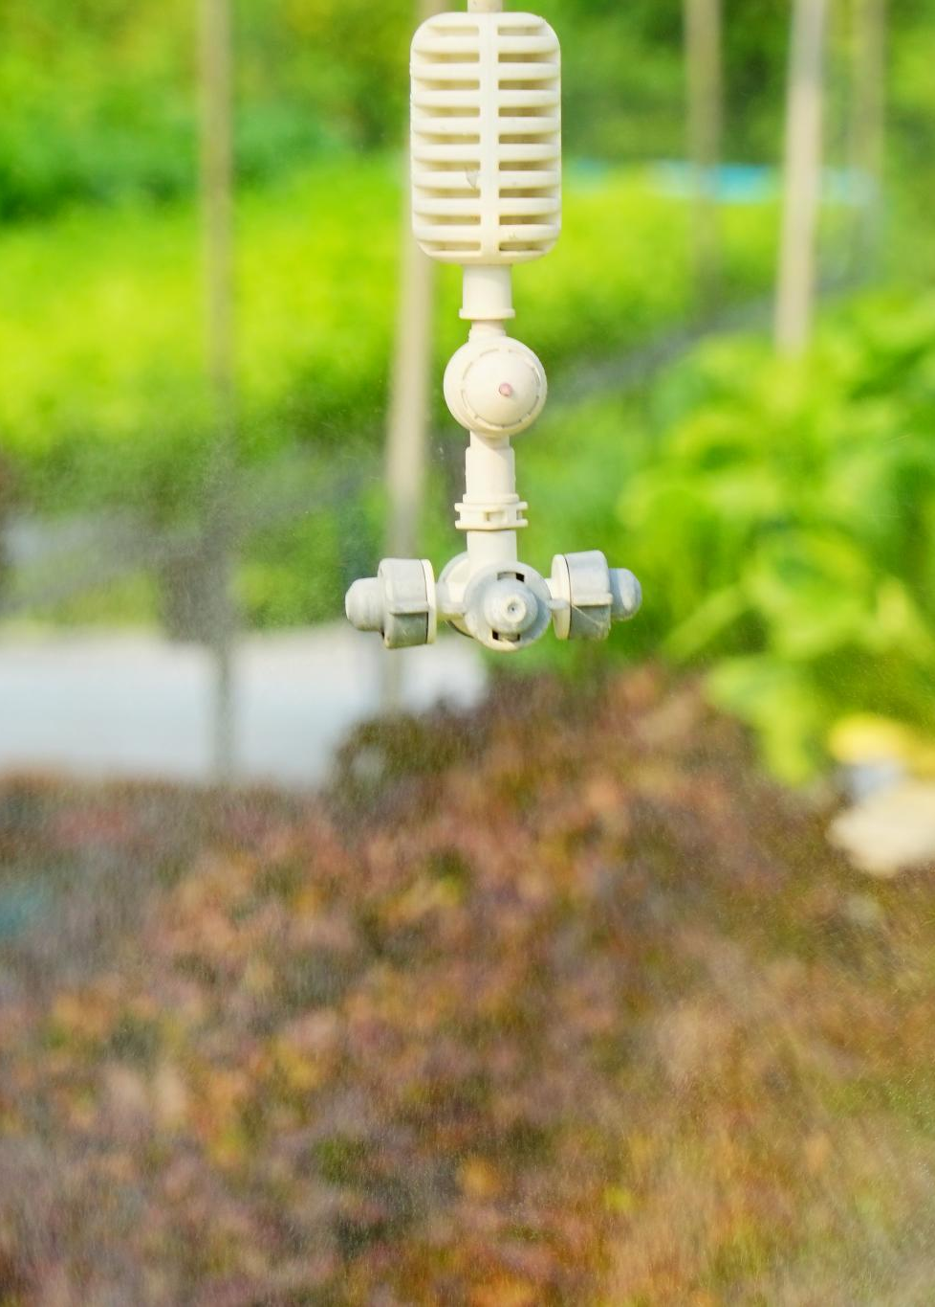
Automated Water Control Based on Humidity Levels
Automated Irrigation Systems
Automated irrigation systems optimize water usage by adjusting schedules based on real-time humidity sensor data.
Efficiency in Water Usage
This technology ensures efficient water usage for plants, reducing waste and promoting healthy growth.
Sensor Technology
Humidity sensors play a crucial role in monitoring soil moisture levels for timely watering adjustments.
Notes:
--- Automated water control adjusts watering schedules based on humidity sensor readings. This ensures plants receive the right amount of water without manual intervention. Image source: Microsoft 365 content library

Slide 29
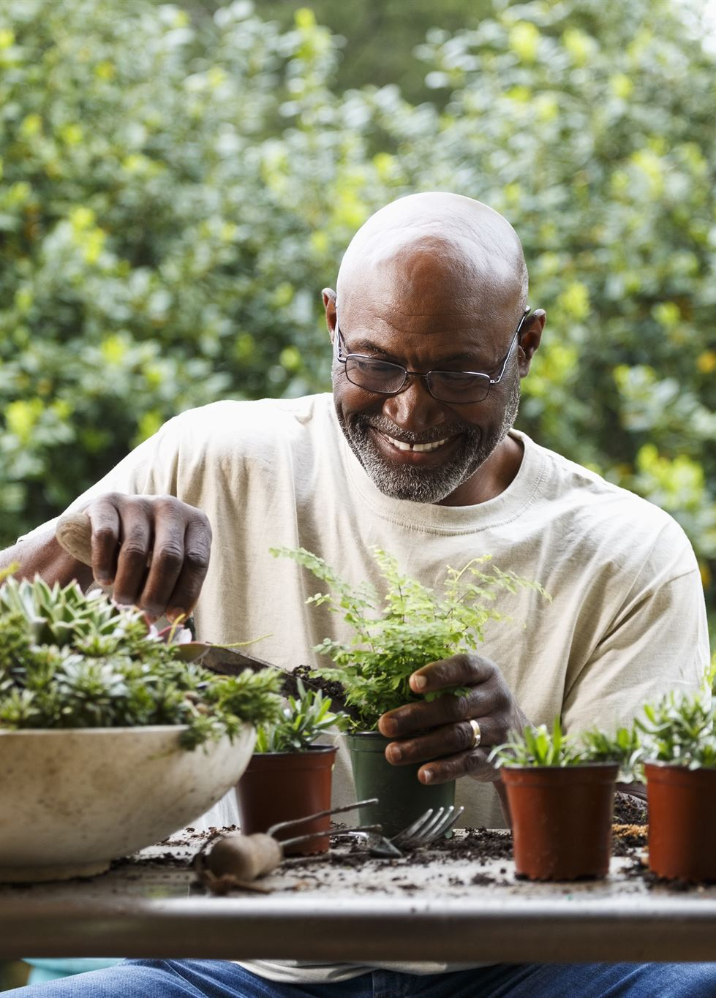
Periodic Maintenance and Troubleshooting
Importance of Regular Maintenance
Regular maintenance is crucial for preventing system failures and ensuring optimal performance of the garden's ecosystem.
Early Issue Identification
Conducting frequent checks allows for early identification of potential problems, safeguarding the garden's health and vitality.
Preventing System Failures
Effective troubleshooting prevents system failures by addressing issues before they escalate into larger problems.
Notes:
--- Performing periodic maintenance and troubleshooting is essential to prevent system failures. Regular checks help identify issues early, ensuring the garden's health is maintained. Image source: Microsoft 365 content library

Slide 30
Conclusion
Efficient Garden Management
Integrating ESP, LoRa, and Raspberry Pi creates an efficient system for monitoring and controlling garden conditions.
Optimal Plant Health
These technologies allow gardeners to maintain optimal conditions for plant growth, enhancing health and yield.
Resource Minimization
The use of these smart technologies reduces labor and resource use, making gardening more sustainable.
Notes:
The integration of ESP, LoRa, and Raspberry Pi in garden automation provides an efficient and effective way to manage garden conditions. By implementing these technologies, gardeners can achieve optimal plant health while minimizing labor and resource use.

Slide 31
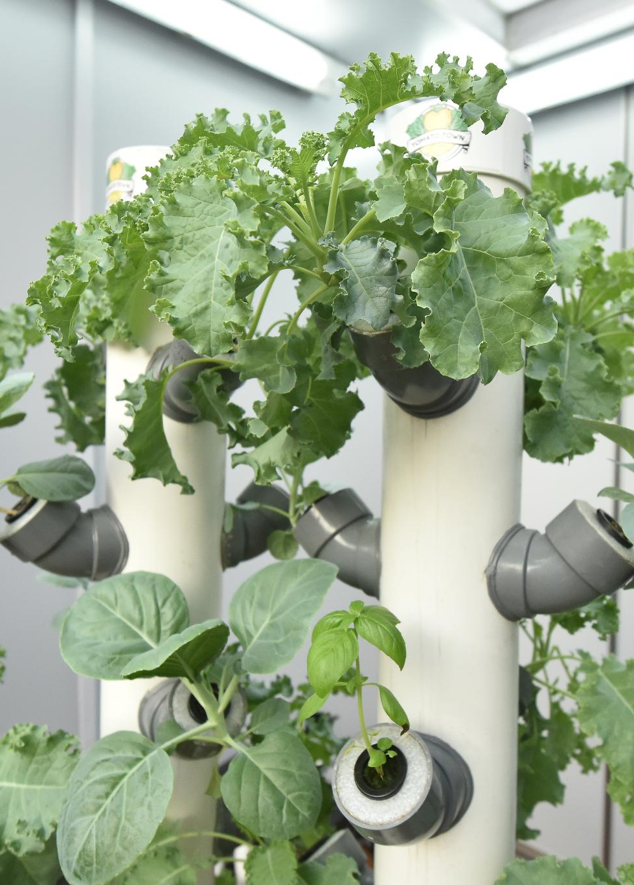
Fair Cost
Efficient Garden Management
Integrating ESP, LoRa, and Raspberry Pi creates an efficient system for monitoring and controlling garden conditions.
Optimal Plant Health
These technologies allow gardeners to maintain optimal conditions for plant growth, enhancing health and yield.
Resource Minimization
The use of these smart technologies reduces labor and resource use, making gardening more sustainable.
Fair Cost of Automation
Investing in automation is a cost-effective solution for long-term garden management.
Notes:
This slide summarizes the benefits of integrating advanced technologies in garden management while highlighting the fair cost of investing in such automation. The initial investment is outweighed by the long-term savings in labor and resources, ultimately leading to healthier plants and improved yield.

Slide 32
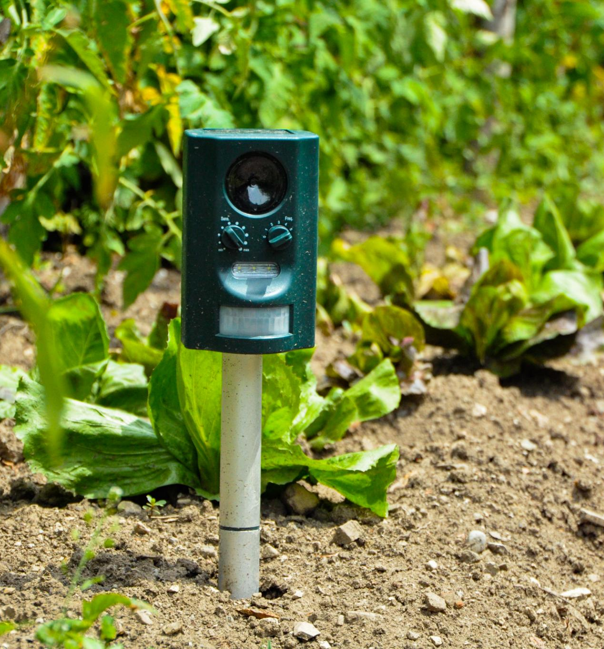
Estimated Material Costs for Garden Automation
12x Soil Sensor: $3 per unit, monitors moisture levels.
1x Humidity/Temperature/Pression sensor: $25 per unit, monitors moisture levels.
1x Raspberry Pi: $210, serves as the central processing unit.
3x ESP + LoRa Module: $30 per unit, provides long-range communication.
3x Water Pump: $50 per unit, automates irrigation tasks.
3x Controller System: $30 per unit, manages various garden components.
Notes:
This slide outlines unreal values for key materials used in garden automation. For example, the soil sensor, priced at $25, plays a critical role in monitoring moisture levels. The Raspberry Pi serves as the central processing unit at $75, while the ESP + LoRa module ensures long-range communication for $50. Additionally, a water pump costs approximately $40, and a controller system is estimated at $60.

